Slide 1
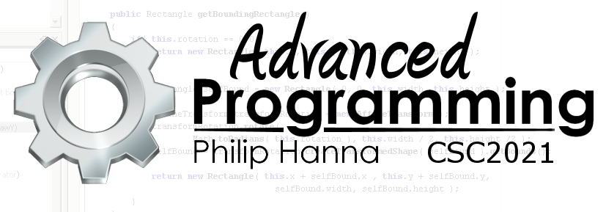
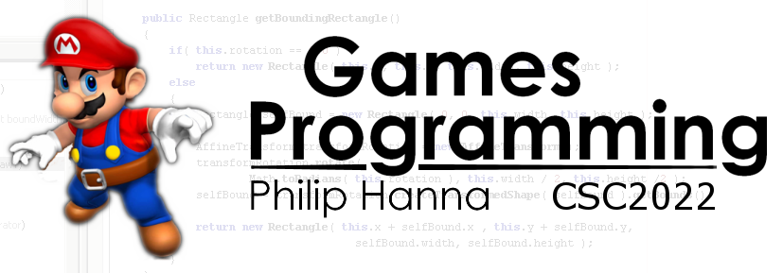
Optimisation
Part 1 – Introduction

Slide 2

Optimisation

Slide 3
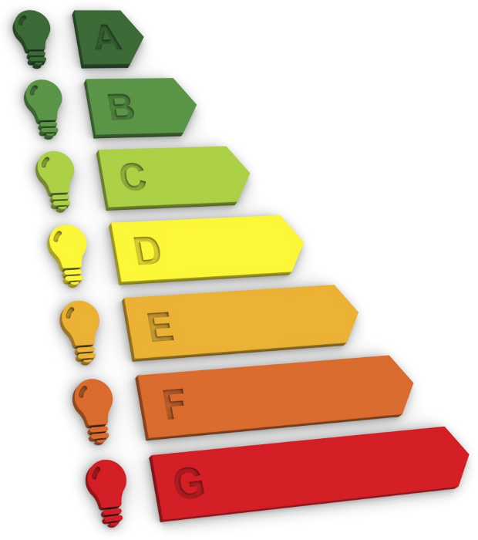
Efficiency
Efficiency entails that a program runs without waste, be this in terms of wasteful CPU cycles, memory usage, etc.
Importantly, a program can be optimally efficiency without necessarily being fast or small (e.g. NP-Complete problems).
We will assume that an efficient, or high-performance, program runs as fast as is possible for the particular task.
Notes:
Efficiency entails that a program runs without waste. Waste can refer to needless CPU cycles (speed), unnecessary data (memory usage) and avoidable disk/network traffic (I/O).
Importantly: The efficiency of a program fundamentally depends upon the problem/task (a program can be optimally efficiency in some regard, say execution speed, without necessarily being, in this case, being fast.
In this section we will assume that an efficient, or high-performance, program runs as fast as is possible for the particular tasks.

Slide 4

Efficiency depends on two key aspects:
Design efficiency:
A pure abstract model of the process. Language independent and typically has the strongest impact on efficiency.
Coding efficiency:
Generally code modifications at the level of the function or block of code.
Notes:
Efficiency depends on two key aspects:
• Design efficiency: This is a pure abstract model of the computational process. The design is largely language independent and typically has the strongest impact on any measure of efficiency (coding efficiencies are unlikely to help much if the design is fundamentally inefficient).
• Coding efficiency: Improving performance here generally involves local modifications (at the level of the function or block or code).

Slide 5

Design Efficiency
Design efficiency can be further defined as:
Algorithms & Data structures:
Selection of sorting, searching, lookup, etc. algorithms and associated data structures.
Program Structure:
Decomposition into subtasks, object hierarchies, functions, data, and function flow.
Notes:
Design efficiency can be further defined as follows.
• Algorithms and data structures: Selection of sorting, searching, lookup, etc. algorithms and associated data structures.
• Program Structure: The decomposition of the problem into interacting subtasks, object hierarchies, functions, data, and function flow.

Slide 6
Coding Efficiency
Coding efficiency can be subdivided as
Language constructs:
System architecture:
Libraries:
Compiler Optimisation:
Use of appropriate data types and language features.
Exploiting the underlying architecture (cached aligned memory access, GPU acceleration, etc.).
Use of libraries (built-in or external) appropriate to the given problem and efficiently written.
Loop unrolling, constant expression loop removal, etc. (can also be programmer introduced).
Notes:
Coding efficiency can be subdivided as:
• Language constructs: Use of appropriate data types and language features.
• System architecture: Exploiting the underlying architecture (cached aligned memory access, GPU acceleration, etc.).
• Libraries: Use of libraries (built-in or external) appropriate to the given problem and efficiently written.
• Compiler Optimisation: Loop unrolling, constant expression loop removal, etc. (can also be programmer introduced).

Slide 7

The design choices you make will have the greatest impact on efficiency. However, to achieve a truly efficient program, an efficient design must be married with efficient code.
Notes:
The design choices you make in your program effect performance far more than language dependent coding aspect.
The above said, efficient algorithms are necessary but not sufficient in their own to guarantee efficient execution. Both factors are important and needed.

Slide 8

Key takeaways:
The design choices you make will have the greatest impact on efficiency.
Sometimes an efficient design must be married with efficient code to achieve performance targets

